Slide 1
Session 7
Black-Box Testing (1)
-- Boundary Value Analysis
chengbaolei@suda.edu.cn

Slide 2
Objectives
In this Session, you will learn
  Introduction of Black-Box Testing
  Boundary Value Analysis
  Equivalence Partitioning
  Decision Table
  Cause-Effect Graph

Slide 3
4.1 Introduction of Black-Box Testing
With black-box testing, the tester views the program as a black-box and is completely unconcerned with the internal structure of the program or system.
The tester focuses on testing the program’s functionality against the specification.
Behavioral, functional, closed-box, input-output …

Slide 4
4.1 Introduction of Black-Box Testing
Why we need Black-box testing?
  Specific knowledge of the application’s code /internal structure and programming knowledge in general is not required.
  The tester only know the "legal" inputs and what the expected outputs should be.
  The tester is aware of what the software is supposed to do but is not aware of how it does it.

Slide 5
 | White-box Testing | Black-box Testing
Tester visibility | have visibility to the code and write test cases based upon the code | have no visibility to the code and write test cases based on possible inputs and outputs for functionality documented in specifications and /or requirements
A failed test case reveals | a problem (a fault) | a symptom of a problem (a failure)
Controlled? | Yes – the test case helps to identify the specific lines of code involved | No – it can be hard to find the cause of the failure
Basic Concepts of White box testing

Slide 6
4.1 Introduction of Black-Box Testing
Typical black-box test design techniques:
  Boundary Value Analysis
  Equivalence Partitioning
  Decision Table
  Cause-Effect Graph

Slide 7
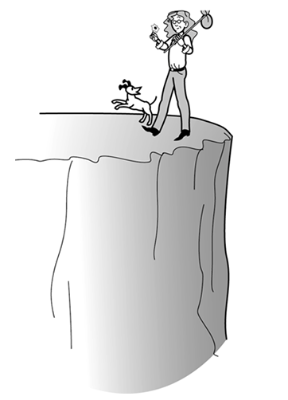
Boundary test
If you can safely and
confidently walk
along the edge of a
cliff without falling off,
you can almost
certainly walk in the
middle of a field.

Slide 8
4.2 Boundary Value Analysis
The rationale behind boundary value testing is that errors tend to occur near the extreme values of an input variable. In another word, errors tend to congregate at the boundaries.
Examples: array, loop, ≤ …
The basic idea of boundary value analysis is to use input variable values at their min, min+, nom, max-, and max.

Slide 9
4.2 Boundary Value Analysis
Example1 (with one variable):
“Input can range from integers 0 to 100,”
Test cases include:
  Min: 0
  Min+: 1
  Nom: 56
  Max-: 99
  Max: 100

Slide 10
4.2 Boundary Value Analysis
What happens when a physical quantity exceeds its maximum?
Robustness Testing
  Robustness testing is a simple extension of boundary value analysis
  We see what happens when the extreme are exceeded with a value slightly greater than the maximum (max+) and a value slightly less than the minimum (min-)

Slide 11
4.2 Boundary Value Analysis
It is based on single fault assumption:
  “Failures are only rarely as a result of the simultaneous occurrence of two or more faults”
  Normal Boundary Values
  Robustness Boundary Values
It is interested in what happens when more than one variable has an extreme value.
  Multiple Variable of Boundary Values (Worst-Case Testing)
  Robust Multiple Variable of Boundary Values (Robust Worst-Case Testing)

Slide 12
4.2 Boundary Value Analysis
  Boundary Value Analysis techniques include:
  Normal Boundary Values
  Robustness Boundary Values
  Multiple Variable of Boundary Values
    (Worst-Case Testing)
  Robust Multiple Variable of Boundary Values
    (Robust Worst-Case Testing)

Slide 13
4.2 Boundary Value Analysis
Example2 (with two variables):
Function F with two variables x, and y
  a =< x =< b
  c =< y =< d
At least how many test cases should be created by using boundary value analysis?

Slide 14
测试用例 | X1 | X2 | 预期输出
T1 | X1nom | X2min | F1
T2 | X1nom | X2min+ | F2
T3 | X1nom | X2nom | F3
T4 | X1nom | X2max- | F4
T5 | X1nom | X2max | F5
T6 | X1min | X2nom | F6
T7 | X1min+ | X2nom | F7
T8 | X1max- | X2nom | F8
T9 | X1max | X2nom | F9
X1取正常值
X2依次取各种边界值
X1依次取各种边界值
X2取正常值

Slide 15
4n+1
边界值
分析
X₂
d
c
X₁
a
b
  Normal Boundary Values
  2 variables to n variables?

Slide 16
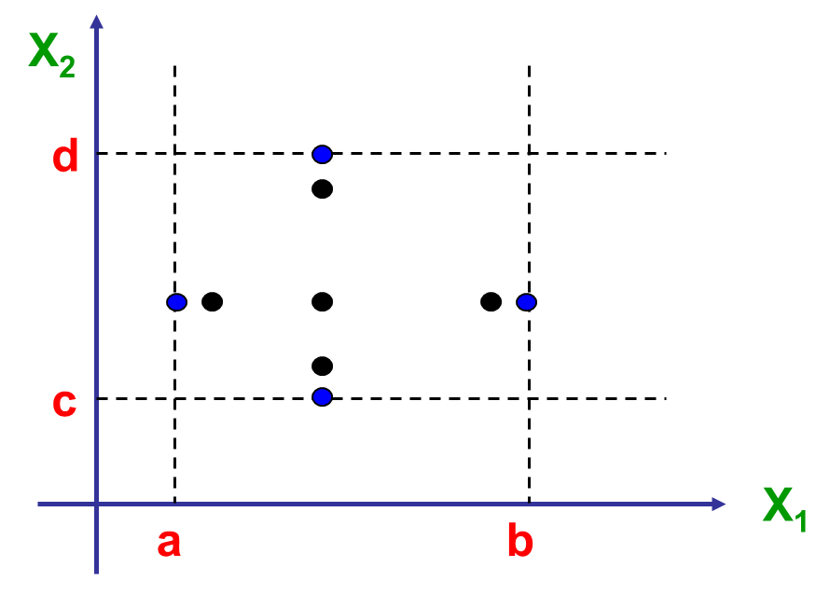
6n+1
健壮性边界值测试
边界值
健壮性测试
●
●
●
●
●
  Robustness Boundary Values

Slide 17

  Multiple Variable of Boundary Values
  / Worse-Case Testing
最坏情况
边界值分析
最坏情况测试
X₂
d
c
X₁
a
b
Test all the combinations of extreme values!
Useful for failure which appears only when two or more variable are at the boundary values

Slide 18

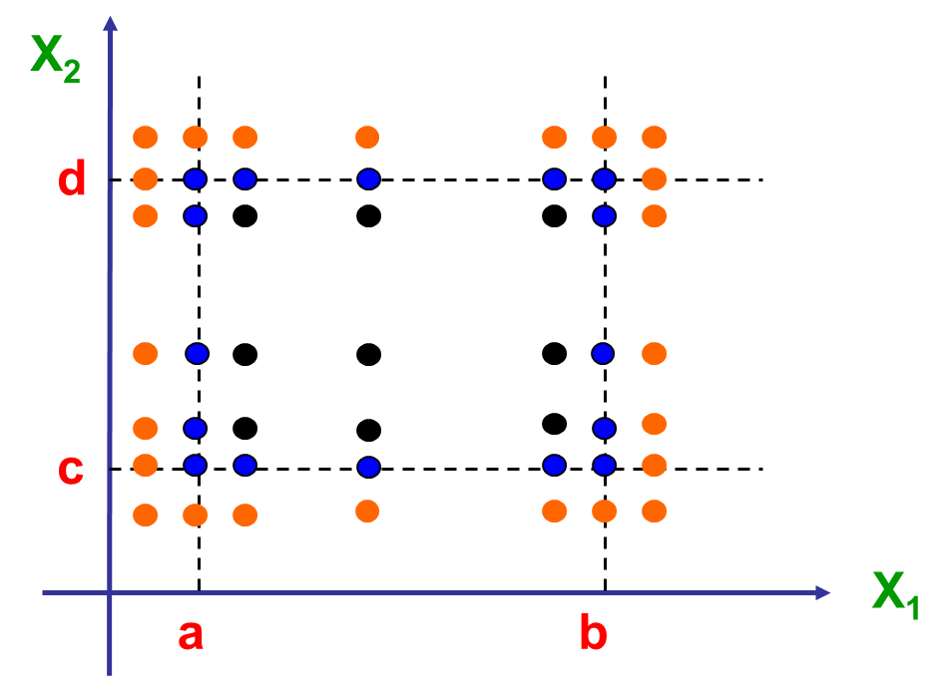
  Robust Multiple Variable of Boundary Values
/ Robust Worst-Case Testing
健壮最坏情况
边界值分析
Also test the invalid extreme values.

Slide 19
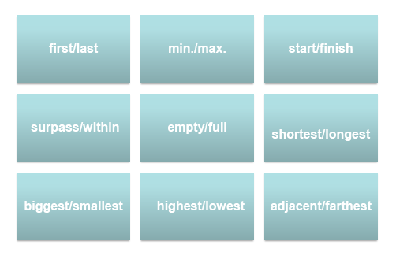
4.2 Boundary Value Analysis
Description of Boundary Value?

Slide 20
4.2 Boundary Value Analysis
Examples:
Characters with input range condition [1, 255]
  boundary values: 1, 255
Read and Write CD-R
  boundary values: Empty file, full files
Printer:
  boundary values: 1 page and maximum pages

Slide 21
4.2 Boundary Value Analysis
Examples:
The Triangle Problem
The NextDate Problem
The Commission Problem

Slide 22
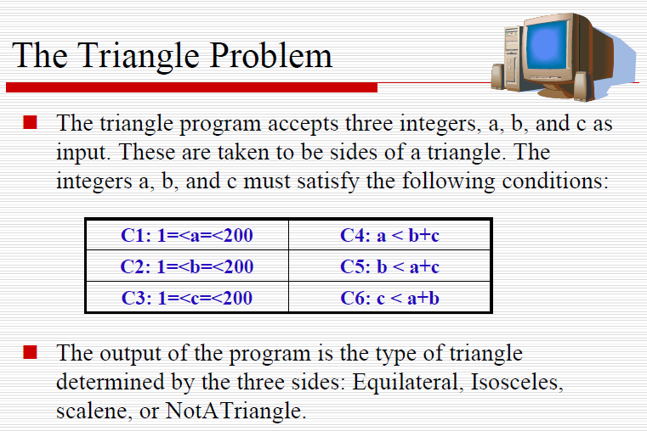

Slide 23
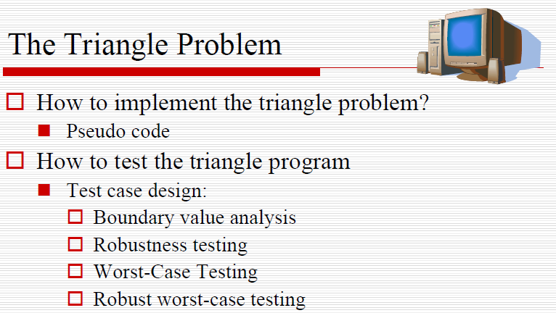

Slide 24
4.2 Boundary Value Analysis
The Triangle Problem
  Test cases for boundary value analysis
13 test cases
NO. | a | b | c | Expected results
1 | 100 | 100 | 1 | I(Isosceles)
2 | 100 | 100 | 2 | I
3 | 100 | 100 | 100 | E(Equilateral)
4 | 100 | 100 | 199 | I
5 | 100 | 100 | 200 | N(NotATriangle)
6 | 100 | 1 | 100 | I
7 | 100 | 2 | 100 | I
8 | 100 | 100 | 100 | E
9 | 100 | 199 | 100 | I
10 | 100 | 200 | 100 | N
11 | 1 | 100 | 100 | I
12 | 2 | 100 | 100 | I
13 | 100 | 100 | 100 | E
14 | 199 | 100 | 100 | I
15 | 200 | 100 | 100 | N

Slide 25
4.2 Boundary Value Analysis
The Triangle Problem
  Design test cases for Robustness Boundary Values.
  How many test cases for Multiple Variable of Boundary Values(Worst-case testing) ?
  How many test cases for Robust Multiple Variable of Boundary Values(Robust Worst-Case Testing)?

Slide 26
4.2 Boundary Value Analysis
The NextDate Problem
  Inputs are three integers: month, date, year
  Output is the next date of the input
  Satisfy the following conditions:
    C1: 1<= month <= 12
    C2: 1<= day <= 31
    C3: 1812<= year <= 2012

Slide 27
4.2 Boundary Value Analysis
  How to test the NextDate problem?
  For month: 0, 1, 2, 6, 11, 12, 13
  For day: 0, 1, 2, 15, 30, 31, 32
  For year : 1811, 1812, 1813, 1900, 2011, 2012, 2013
Some impossible test cases
  2-30-1900, 6-31-2012…
Miss some important test cases
  28 or 29 in February
  Leap year: 2000

Slide 28
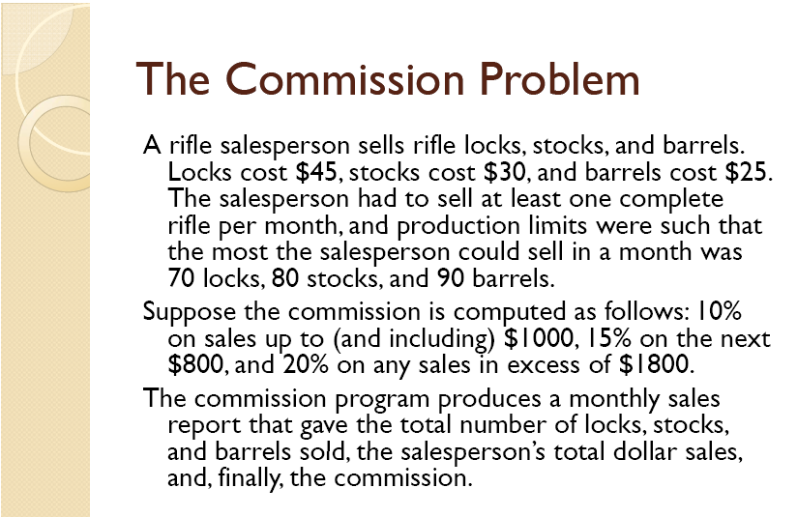

Slide 29
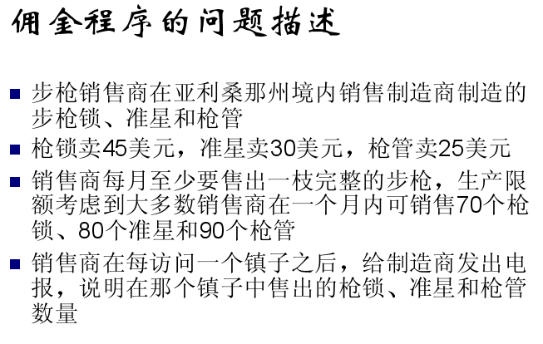

Slide 30
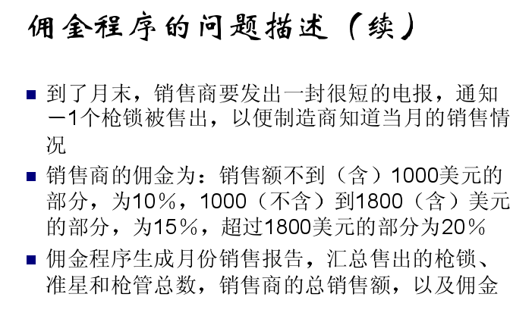

Slide 31
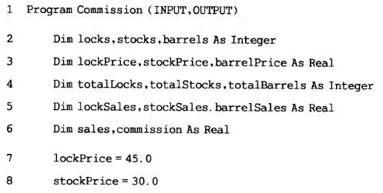
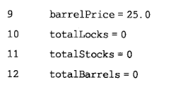

Slide 32
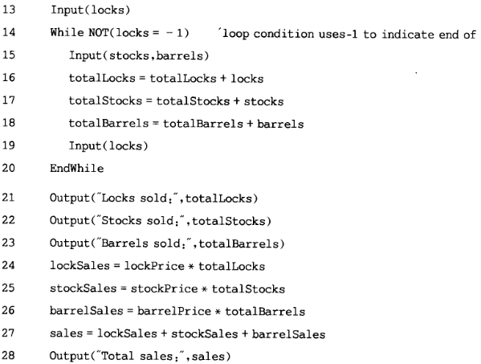

Slide 33
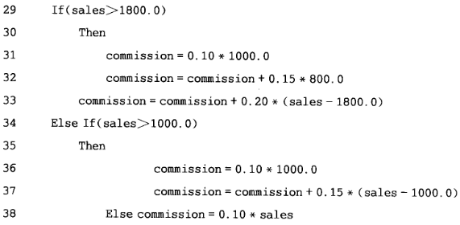
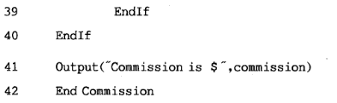

Slide 34
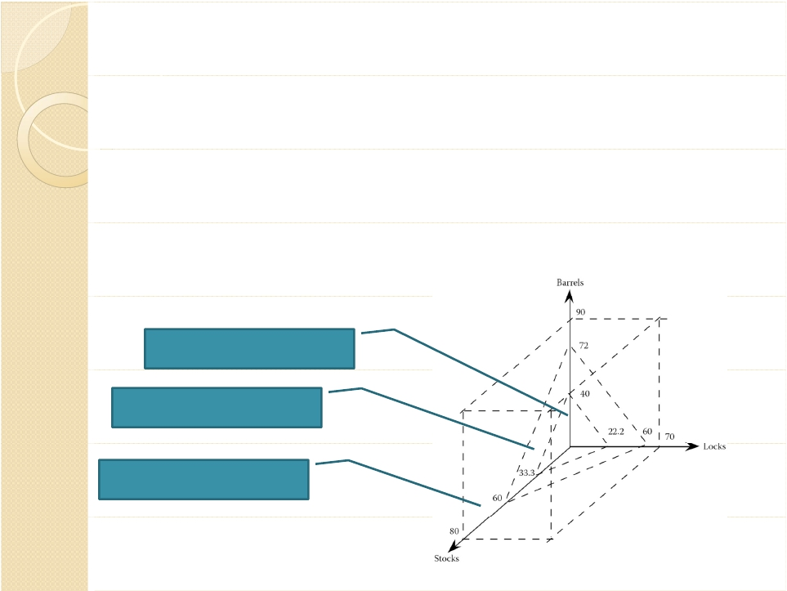
Test Cases for the Commission Problem
We focus on boundary values for the
output range,especially near the
threshold points of $1000 and $1800.
10% commission
15% commission
40
20% commission

Slide 35
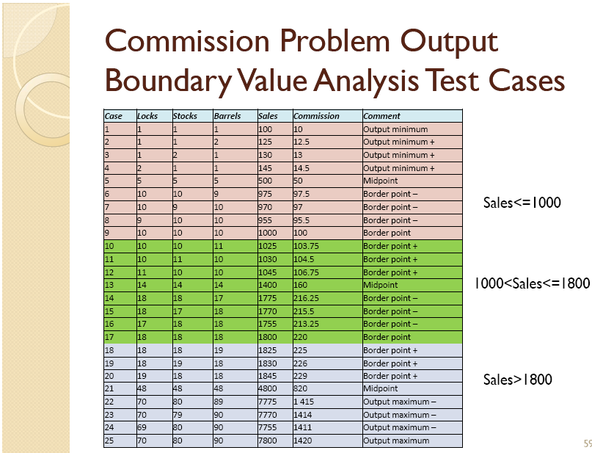

Slide 36
4.2 Boundary Value Analysis
  Boundary Value Analysis techniques include:
  Normal Boundary Values
  Robustness Boundary Values
  Multiple Variable of Boundary Values
    (Worst-Case Testing)
  Robust Multiple Variable of Boundary Values
    (Robust Worst-Case Testing)
It can be applied for the input/output range

Slide 37
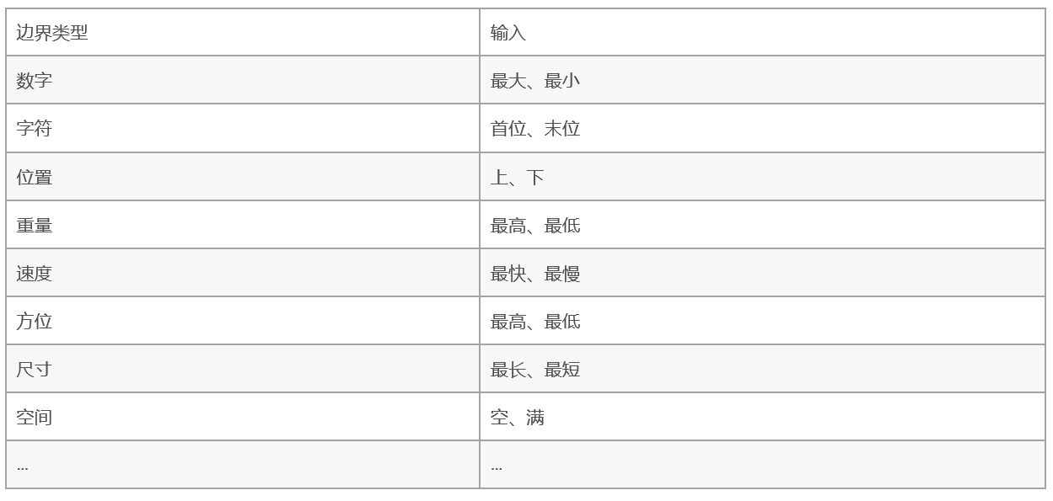
边界值检验的主要类型

Slide 38
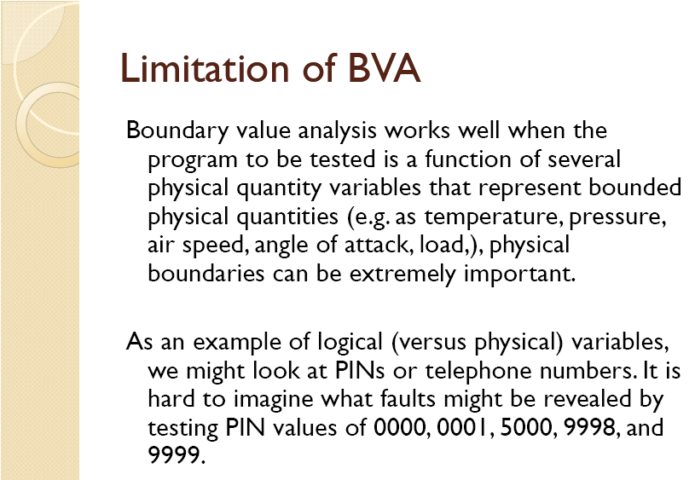

Slide 39
4.2 Boundary Value Analysis
Questions?
What is the advantages of Boundary Value Analysis?
What is the limitations of Boundary Value Analysis?

Slide 40
4.2 Boundary Value Analysis
What is the advantages of Boundary Value Analysis?
  Given the boundary, it is easy and cheap to design test cases
  N parameters produce 4n+1, 6n+1, 5^{n}, 7^{n} test cases
  Different data type have different boundary value selection
What is the limitations of Boundary Value Analysis?
  Suppose parameters are independent
  Ignore the semantic information of parameters
  Boundary value analysis is not useful for a Boolean variable

Slide 41










Exercise 1
There are three integer inputs x, y, z, corresponding to the length, width and height of a rectangle respectively. All of these three inputs are in the range of [2, 20], the output is the volume of the rectangle.
  List the number of test cases that needed by four types of boundary value analysis respectively.
  Design the test cases by Robustness Boundary Value Analysis.

